Slide 1
Professional Ethics
Created by Kenil Bhatt, Kristen Bishop, Wasif Bokhari, Jeremy Booker, Jordan Born, John Bravo, and Davon Brown

Slide 2
Software Development

Slide 3

Professional Ethics in
Software Development
The set of moral principles that govern a person’s behavior with each other (i.e., colleagues) and people outside of person’s profession (i.e., clients or customers.).
Differs from Personal Ethics
Notes:
Professional ethics: company’s rules and regulation before personal moral issues.
I realize that there are different views of morality and we could go down a very slippery slope discussing them.

Slide 4
Software Development Process
Requirement Specification and Analysis
Software Design
Implementation and Integration
Testing or Validation
Deployment or Installation
Maintenance

Slide 5

Impact of Ethics in
Software Development
Use of software range from personal calculators to powerful X-ray scanners.
Quality of the Software
  Safety
Development cost
  Time it takes to hit market
Ease of use

Slide 6
Software Quality Assurance
Identify and remove bugs from the software at early stage of development process.
  Safer and Efficient
  Saves Money
Software Testing
  Dynamic, Static, Integration, System, and User acceptance.
Notes:
No need for recalls, which drastically increases cost.
Software product liability

Slide 7
Software Quality Assurance(QA)
Dynamic Testing
  Black-box: Tester has no knowledge of the code.
  White-box: Tester has knowledge of the code.
Statics Testing: Manual checking
Integration Testing: code integration with subsystem.
System Testing: Entire System is tested.
User-Acceptance: Tested by independent users.

Slide 8
Professional Codes Across Disciplines

Slide 9
Why?
Reinforces the moral principles
Commitment of an organization
Lays out acceptable and responsible behavior

Slide 10
Components
What the company aspires to
Explains the values of the company
  procedures that the personnel can follow
  covers potential ethical issues
  procedure for handling issues

Slide 11
Examples of Organizations in Engineering
National Society of Professional Engineers
National Society of Programmers
International Programmers Guild
International Software Testing Qualifications Board
Most organizations follow the AMC's code (Association for Computing Machinery)

Slide 12
NSPE Code of Ethics for Engineers
Preamble
  the services provided by engineers require honesty, impartiality, fairness, and equity, and must be dedicated to the protection of the public health, safety, and welfare.
I. Fundamental Canons
  Engineers, in the fulfillment of their professional duties, shall:
    Hold paramount the safety, health, and welfare of the public...

Slide 13
NSPE Code of Ethics for Engineers
II. Rules of Practice
  Engineers shall hold paramount the safety, health, and welfare of the public.
    If engineers' judgment is overruled under circumstances that endanger life or property, they shall notify their employer or client and such other authority as may be appropriate.
III. Professional Obligations
  Engineers shall acknowledge their errors and shall not distort or alter the facts.

Slide 14
IEE and ACM codes

Slide 15
Definition
IEEE - Institute of Electrical and Electronics Engineers
ACM - Association for Computing Machinery

Slide 16
Professionalism
  Commit ourselves to the highest level of ethical and professional conduct
Responsibilities
Uphold the law
Behave in an honest and ethical manner

Slide 17
Introduction
Making the following a beneficial and respected profession
  Analysis
  Specification
  Design
  Development
  Testing and Maintenance of software

Slide 18
Eight key principles
Public
Client and Employer
Product
Judgment
Management
Profession
Colleagues
Self

Slide 19
Areas of concern
Confidentiality
Competence
Intellectual property rights
Computer Misuse

Slide 20
SECEPP

Slide 21
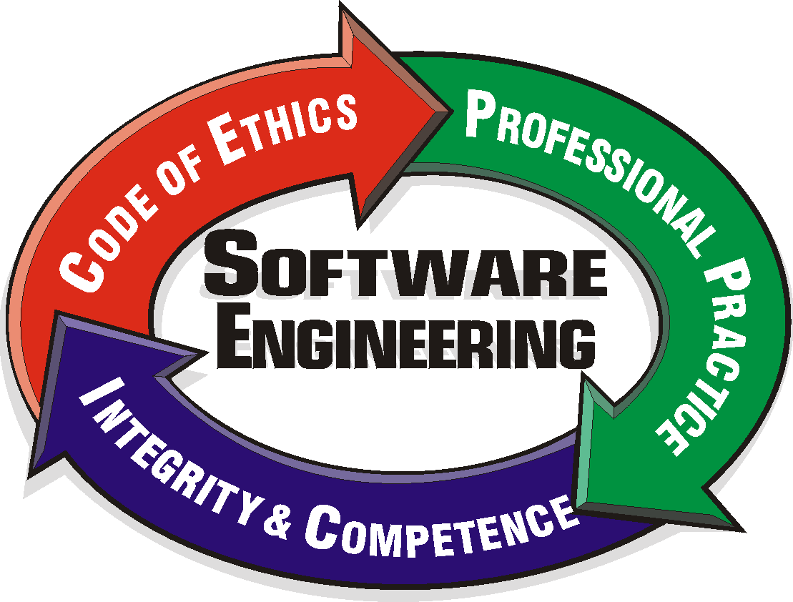
SECEPP
Software Engineering Code of Ethics and Professional Practice
  International standard for Software Engineering
  Represents a moral commitment to the public
  Provides a system to resolve conflicts
Notes:
-

Slide 22


History
Developed from participants from all around the world
  US, China, Croatia, Israel, UK
Supported and Adopted by both
  ACM
  IEEE Computer Society

Slide 23
The Code
Consists of Eight Principles
  Public
  Client and Employer
  Product
  Judgment
  Management
  Profession
  Colleagues
  Self

Slide 24
Public
“Software engineers shall act consistently with the public interest”
Accept responsibility for your work
Approve software only if believed to be safe.
Avoid deception
Disclose potential dangers

Slide 25
Client and Employer
“Software engineers shall act in a manner that is in the best interests of their client and employer, consistent with the public interest”
Use software that is obtained only legally
Keep confidential information private
Report to client/employer when problematic

Slide 26
Product
“Software engineers shall ensure that their products and related modifications meet the highest professional standards possible”
Strive for highest quality and acceptable cost
Identify and address issues
Always provide satisfactory testing
Treat software maintenance with the same amount of focus as new development

Slide 27
Judgment
“Software engineers shall maintain integrity and independence in their professional judgment”
Only endorse documents within area of competence
Not engage in deceptive financial practices
Disclose conflicts of interest

Slide 28
Management
“Software engineering managers and leaders shall subscribe to and promote an ethical approach to the management of software development and maintenance”
Ensure SE are informed of these standards
Never punish anyone expressing ethical concern

Slide 29
Profession
“Software engineers shall advance the integrity and reputation of the profession consistent with the public interest”
Promote public knowledge of Software Engineering
Extend personal knowledge by participation in professional organizations
Support others who follow this code

Slide 30
Colleagues
“Software engineers shall be fair to and supportive of their colleagues”
Encourage others to follow this code
Always credit other people’s work
Assist colleagues in development work
Call upon help from others when working in areas with a lack of skill

Slide 31
Self
“Software engineers shall participate in lifelong learning regarding the practice of their profession and shall promote an ethical approach to the practice of the profession”
Always focus on ethical applications
Improve personal ability to create safe and reliable software
Recognize that violations of the code are inconsistent with being a professional SE

Slide 32
Overall Benefits
Attract Employees
  Results in quality software
Public Concern
  Leads to a dependable reputation
Professional Image
  Gain respectability for the software you produce
Public Trust
  Best interests are always being met
Internal Standards
  Improve communications between management and colleagues

Slide 33
Windows Vulnerabilities

Slide 34
Vulnerability
“Flaw in an information technology product that could allow violations of security policy”
Anecdotal evidence - Known and patchable vulnerabilities cause majority of system intrusions

Slide 35
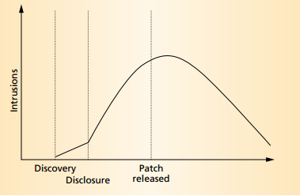
States of a Vulnerability
Birth, discovery, disclosure, correction, publicity, scripting, death
Due to causal link, first 3 always in order, however after initial disclosure, 3-6 can occur in any order

Slide 36
Confirmed Examples
Severity
Windows License Logging Service could allow code execution
Administrator accounts’ passwords don’t expire
Microsoft Windows remote desktop protocol server private key disclosure
  Man-in-the-middle attack – read, insert, modify messages between two parties using remote desktop

Slide 37
Remote-Access Password
Password Hint stored in OS registry
  Jonathan Claudius wrote an 8-line Ruby script which decodes line in security accounts manager section of register that contains password hint
  If a hacker has remote access, they can get this password hint now

Slide 38
Problems Today
Windows 8 IE 10 Flash Player
  Aug 21, 2012 Adobe released update to Flash Player
    “vulnerabilities that could cause a crash…allow an attacker to take control of the affected system”
  Windows 7 and prior devices with automatic updates got the update automatically
  Microsoft integrated Flash Player into IE 10, not 3rd party plug-in – cannot manually update
    October 26 – “GA timeframe” fix date from Microsoft

Slide 39
Patch Tuesday
Monthly patching schedule, in last 2 years only 1 outside of schedule
If Windows 8 was available all 2012 and Adobe and Microsoft didn’t change update days, 77 days of vulnerability through Sept 11
Longest at one time 27 days when Flash updates occurred day after Patch Tuesday
In contrast, Chrome updates same day as Adobe, sometimes ahead of Adobe patch

Slide 40
Fix the Problem?
Vulnerabilities will always exist
Ways to make them less of a problem
  Update more regularly
  Increase public knowledge
  More preventative measures by developers to find problems before hackers

Slide 41
WHISTLE BLOWING

Slide 42
Whistle Blowing?
The act of disclosing unethical or illegal behavior of a company by one of its employees or former employees is called whistle blowing
  This can be classified as internal whistle blowing - where the activity is reported within the company
  Or external whistle blowing - where the activity is disclosed to the public.

Slide 43
Why Blow the Whistle
“To serve the best interest of the consumers”
  This is especially true when the safety of the public is concerned
  There have been serious moral problems that could have been prevented by whistle blowing
“To express dissent”
  Engineers whistle blow to protest against bureaucracy within their companies.
  very small percentage of whistle blowers (at least in cases involving engineering)

Slide 44
Dilemma
Should the employee remain loyal to their company?
  “save face” for their colleagues and companies
  Whistle blowing could lead to lost of jobs and etc, especially if the activity being reported reaches the media.
Especially when safety is involved, does the employee have an obligation to blow the whistle on their companies' activities.
  Many modern codes of engineering stress the importance of public welfare.

Slide 45
Dilemma
Many engineering codes of conduct have also made it difficult to balance responsibility to the company and serving of public interest
  For example, the 1st American Code of Engineering (1912) only mentioned the goal of helping the public understand engineering matters
  While a more modern “Canons of Engineering Ethics of the Engineering Council for Professional Development” contained more explicit statements of the responsibility of engineers to the public.
Is a moral idea like serving public interest worth losing ones career and losing a steady income?

Slide 46
Consequences of Whistle Blowing
Viewed as sneaks or cowards by colleagues
  Face ostracization at the work place
Far reaching consequences can be felt even for those that the whistle blower associates with, like family and friends.
  Disintegration of interpersonal relationships because of mental strain or financial pressure
Reputations
  While, whistle blowing could lead into false accusations, which could tarnish the reputation of the accused, those that accuse also face the possibility of never having a job again.
Retaliation by colleagues and employers
  It is rare for an employee to whistle blow and still keep his job

Slide 47
Case Study: Salvador Castro
Medical electronic engineer in at Air-Shields Inc.
Observed a serious flaw in one of the companies incubator that was both relatively easy and inexpensive to fix.
Castro was fired when he attempted to notify the U.S. Food and Drug Administration
Has only been able to find sporadic work after being fired.

Slide 48
Case Study: Walter Tamosaitis
Worked for the natures nuclear weapons cleanup company
The project he was working on involved embedding waste into solid glass and shipping it into a dump.
"abruptly removed from the project" after stating that the safety of the project was flawed
Ostracized from staff meetings and he is currently relegated to a basement office
Tamosaitis considers his reputation destroyed and managed as many as 30 in house engineers
He holds a doctorate in systems engineering

Slide 49
Is It Worth It?
Whistle blowing is a clear dilemma in engineering
“The technical knowledge and organizational positions of engineers enable them to detect serious moral problems that affect the public welfare”
The dilemma that engineers face is remaining loyal to their company or losing an, arguably, steady income/career to serve the public.

Slide 50
Conclusion

Slide 51
Review
Software Development
  Important factors in Software Development are how safe the software is, the cost of development, and its ease of use.
Professional Codes Across Disciplines
  Explains the values of the company

Slide 52
Review
SECEPP
  Is the international standard for software engineering
Windows Vulnerabilities
  Vulnerabilities are defined as a “flaw in an information technology product that could allow violations of security policy”
  They will always exist, but there are ways to minimize the problem

Slide 53
Review
Whistle Blowing
  disclosing unethical or illegal behavior of a company by one of its employees or former employees
  can lead to being ostracized at the work place, loss of interpersonal relationships, loss reputation, and even losing one’s job

Slide 54
Discussion Question
Your in a situation where the company risks losing millions all because you found a major error in something.
However, your boss said that the matter would be resolved after it is released
Would you do the morally right thing and risk losing your job, reputation, and future employment, or would you keep your mouth shut and resolve the problem later?

Slide 55
Citations
http://www.ibm.com/developerworks/rational/library/may06/pollice/index.html
Dr. Klaus Mueller, Presentation on Professional Ethics in Computer Science.
IEEE-CS/ACM Software Engineering Code of Ethics and Professional Practice http://www.computer.org/tab/seprof/code.htm
http://www.napusa.org/pcoe.php
http://www.nspe.org/Ethics/CodeofEthics/index.html
https://engineering.purdue.edu/MSE/Academics/Undergrad/ethics.pdf
http://www.seas.upenn.edu/undergraduate/pdf/NSPECodeofEthics.pdf
http://www.ehow.com/facts_5490008_purpose-code-ethics.html
http://www.wisegeek.com/what-is-a-code-of-ethics.htm
http://www.cs.toronto.edu/~sme/CSC340F/slides/tutorial-ethics.pdf

Slide 56
Citations
http://csciwww.etsu.edu/gotterbarn/secepp/default.asp
http://csciwww.etsu.edu/gotterbarn/secepp/page.asp?Name=History
http://csciwww.etsu.edu/gotterbarn/secepp/organizations.asp
http://csciwww.etsu.edu/gotterbarn/secepp/page.asp?Name=Code
http://cs.txstate.edu/~ch04/webtest/teaching/courses/2315/lectures/prof-ethics-general-portrait.pdf
http://csciwww.etsu.edu/gotterbarn/secepp/images/newLogo.gif
http://upload.wikimedia.org/wikipedia/en/1/19/Association_for_Computing_Machinery_logo.png
http://www.cse.fau.edu/ictai2011/links/computer.gif
http://www.acm.org/about/se-code
http://www.ieee.org/about/corporate/governance/p7-8.html

Slide 57
Citations
http://www.cs.umd.edu/~waa/pubs/Windows_of_Vulnerability.pdf
http://www.oit.umn.edu/prod/groups/oit/@pub/@oit/@web/@security/documents/content/oit_content_248401.pdf
http://www.zdnet.com/microsoft-puts-windows-8-users-at-risk-with-missing-flash-update-7000003834/
http://www.pcworld.com/article/262045/adobe_admits_flash_exploits_threaten_windows_8.html
http://arstechnica.com/security/2012/08/windows-8-password-hints/
http://www.nspe.org/Ethics/EthicsResources/Otherresources/whistle.html
http://ethics.iit.edu/publication/WhistleBlowing_Peterson1.pdf.
http://mathieu.bouville.name/education-ethics/Bouville-whistle-blowing.pdf
http://spectrum.ieee.org/at-work/tech-careers/the-whistleblowers-dilemma

